Slide 1

IST 722 Data Warehouse Presentation
Group 2
Dr. Block

Slide 2

Agenda
Project Introduction, Project Overview and Project Scope
Project Delivery, Milestones, Planning, Costs and ROI
Functional Requirements and Business Processes
Design
SSIS: Packages Deployment
SSIS: Business Intelligence (BI)
Project Instructions: Follow Up Questions
Live DEMO
Q&A

Slide 3
Introduction, Project Overview & Project Scope

Slide 4
Introduction to Fudgemart and Fudgeflix
Fudgemart
Fudgemart is a fictitious retailer, similar to Amazon.com/Walmart.com
Fudgemart database consists of customers, products, and vendors, and has online retail business processes
Fudgemart database:
'Fudgemart_v3'
Fudgeflix
Fudgeflix is a fictitious online DVD-by-mail and video-on-demand service, similar to Amazon Instant Video or Netflix
Fudgeflix database contains concepts of accounts, subscriptions, and video titles, as well as other things associated with an online video-streaming service
Fudgemart database:
Fudgeflix_v3
Third database: ExternalSources2 --> has some useful data sets for data warehousing in general as well as some Fudgemart sets with FM in their object names

Slide 5
Mission Statement and Company Vision
Along with our quality products, best service and the best prices @ FudgeMart and FudgeFlix; we will always go the extra mile to give our customers the best selection and provide the use of those products to their maximum benefit!
We will always satisfy the customer needs with the best service and cost!!!

Slide 6
Project Overview Business Case
This project is focused on creating a centralized data warehouse repository that consists of aggregated data coming from different sources
The data warehouse Data Marts will provide a decision support system in which user can calculate and evaluate the performance of the organization over time
The Data Warehouse will allow Fudgemart and FudgeFlix the ability to analyze historical data and compare among the time periods. These comparisons can help user make important business decisions
With the volume, velocity and variety of data, Fudgemart needs a way to store this data efficiently and to utilize it for improving various aspect of business
Data Warehouse plays an important role. It helps to analyze key aspects to improve sale. Anticipating what customers want and need to buy will position Fudgemart to stay one step ahead of the game
Ad-Hoc reporting and dashboard creation for the generation of attribute, product, inventory specific data can be done using warehousing techniques

Slide 7

Project Scope
Create a Data warehouse that provides an estimate of the sales and inventory based on historical data
Create BI for FudgeMart and FudgeFlix based on historic data that can be used for analytics
Create testing and support environments
Create Data Warehouse, Data Marts and Decision Support System Generation modules
Provide employees and End User training pre-deployment phase
Provide maintenance and support plan

Slide 8
Project Team
Yehuda Perry: Project Manager & BI Architect
Jafar Hosseinzadeh: Data Architect
Joseph Rinaldi: Business Analyst
Bayli Berry: ETL Architect

Slide 9
Stakeholders (Fudgemart and Fudgeflix)
Project Sponsor: Secure funding
Sales, Marketing, Finance, IT, CIO and Supply Chain Management representatives
Technical Implementation Team: Project Manager, Data Architect, Business analyst and BI specialist
End Users: End users that will use the DW and BI platforms

Slide 10
Project Delivery, Planning, Cost and ROI

Slide 11

Project Deliverables
Project Documents: project charter, project plan, outline functional requirements, overview business processes, assign primary roles (team members)
High-level Dimensional Modeling: bus matrix, attributes and matrix, outline issues
Detail-level Dimensional Modeling: fully completed dimensions and facts, identifying sources for source-to-target map, generating SQL schema
Data warehouse on SQL Server: follows consistent conversations, adopting techniques for use of staging and enterprise bus matrix
Completed!

Slide 12
Our Group Project Deliverables Cont.
ETL Done in SSIS: source-to-target map, SSIS package to stage our data, SSIS package to load to DW from stage, ETL documentation (Screenshots, etc.)
Business Intelligence: SSAS cubes on analysis services server, power BI graph and charts, BI documentation (describe the goal of our analytics and type of BI)
Business Intelligence: SSAS cubes on analysis services server, power BI graph and charts, BI documentation (describe the goal of our analytics and type of BI)
Presentation and Demo: executive level presentation overviewing our DW/BI initiative, BI demo
Completed!

Slide 13
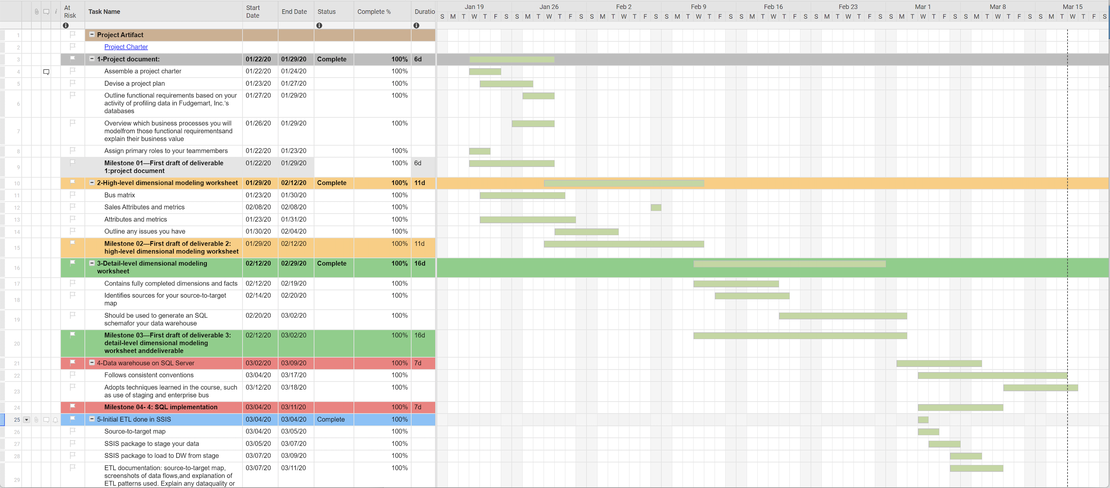
Project Planning

Slide 14
Project Cost
Hardware and Storage
Human Resources: PM, Research and Development (R&D) → DW and BI, Maintenance & Support
Data Preparation\ETL
Customizations
Software Licensing
Maintenance and Support
Training
Total Estimation: ~ $ 500,000 Annually
Building a data warehouse from scratch is no easy task!!
A large project such as this requires more than a year of setup, configuration,
and optimization before it is ready for business intelligence purposes!

Slide 15
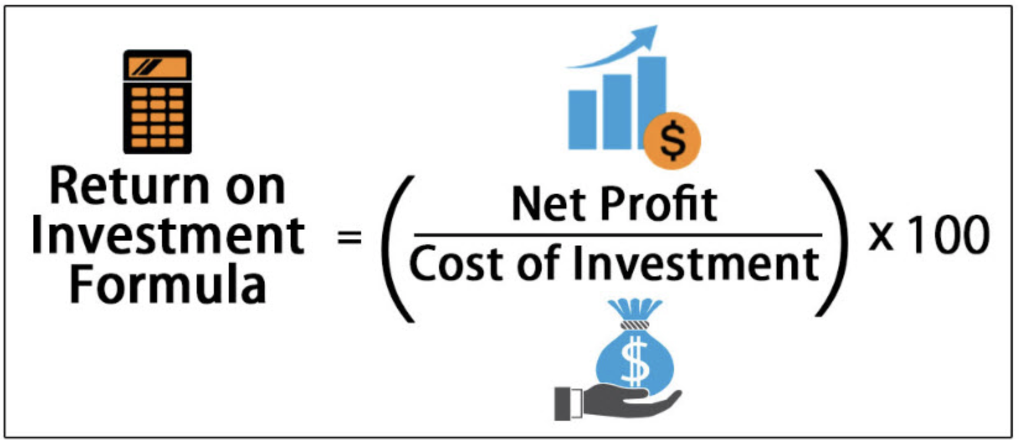
Project Return of Investment (ROI)
The ability to analyze price strategy
Improve decision making quality through informed, fact based decisions
Faster Decisions
Greater management visibility as to what is taking place
Support for business strategies
Increase market share
Avoid sales lost to competitors

Slide 16
Functional Requirements and Business Processes

Slide 17
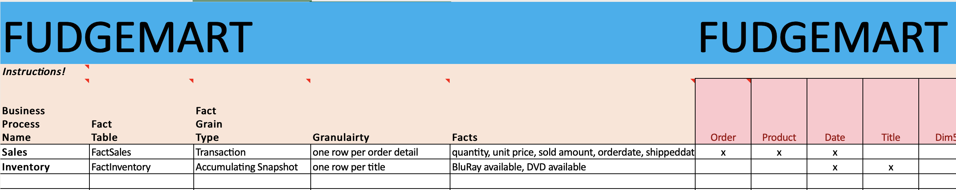
Identified Functional Requirements

Slide 18
Selected Business Processes
Fudgemart
Sales: allows the company to review sales information from orders and shipment of those orders
Value: reflects on which products are the most profitable and how long orders take to fulfill
Fudgeflix
Inventory: allows the company to review how many DVDs and BluRays discs are in stock daily
Value: predictive capabilities based on historic data to have enough stock to satisfy busy months/weeks, but avoid holding too much stock that is not being used

Slide 19
Design

Slide 20
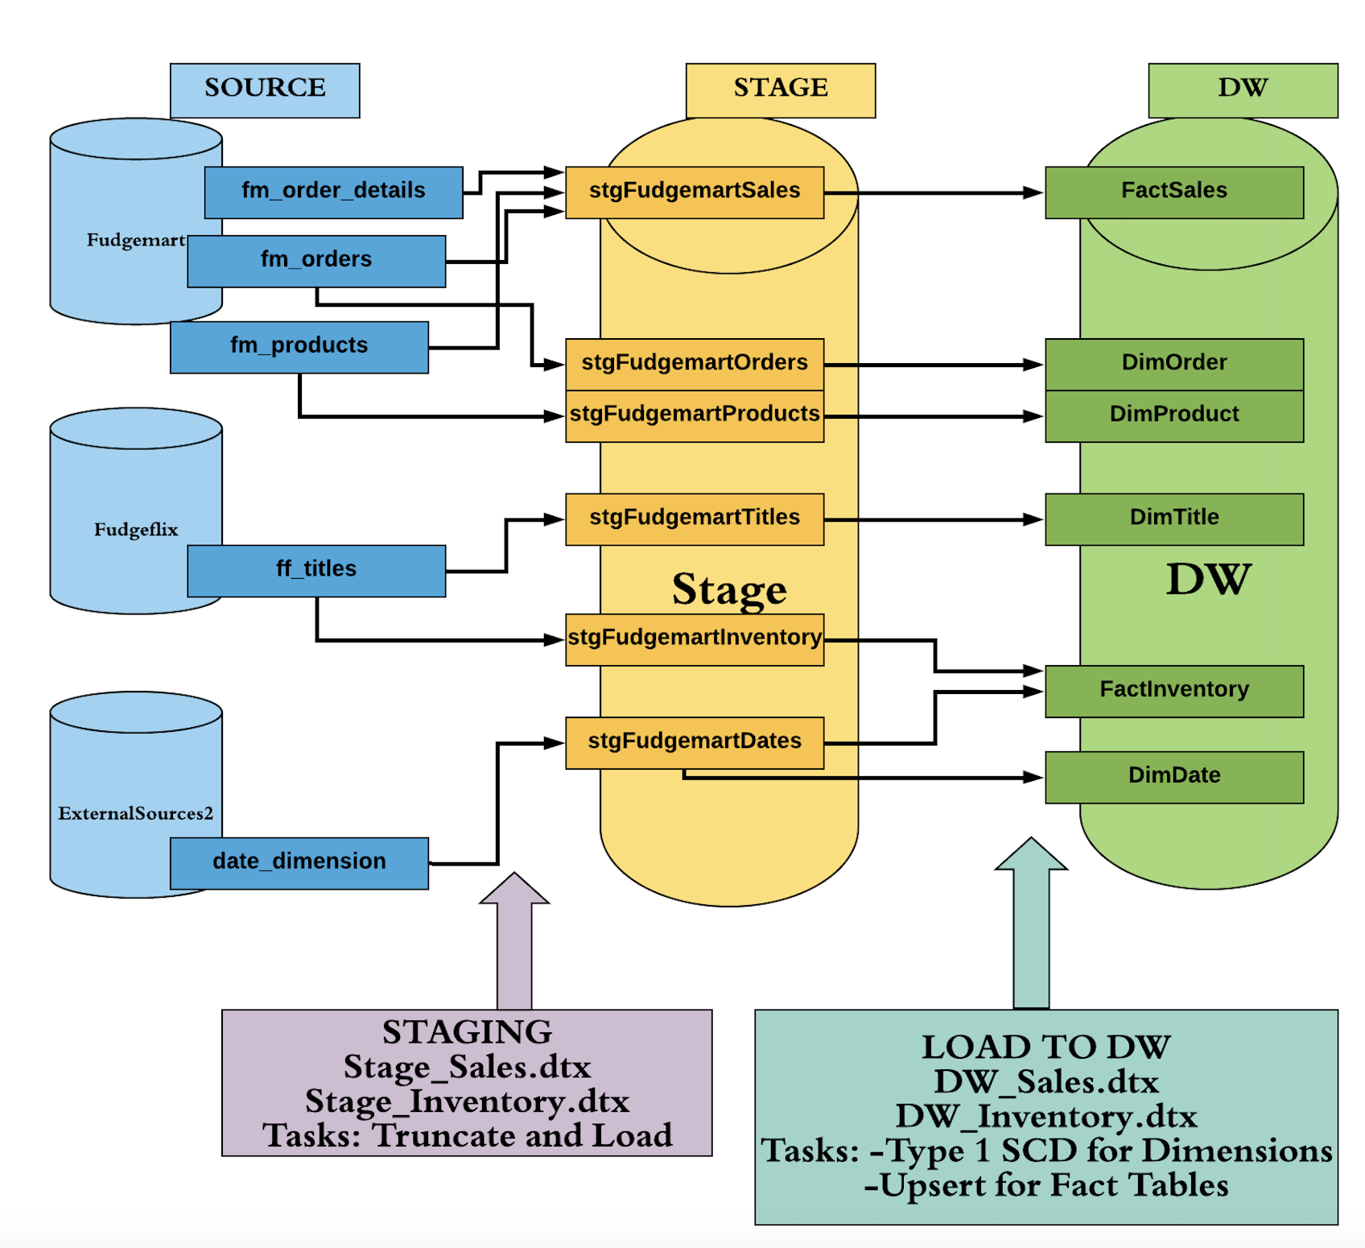
High Level Source to Target Map

Slide 21
High Level Source to Target Analysis
Identified all source systems that have data to be extracted from
Identified valuable data and formed aggregation/summarization strategies
Identified data types and their corresponding data types in the ETL tool used for the process
Summarized data in such a way that valuable information is not lost, and storage costs are kept at a minimum

Slide 22
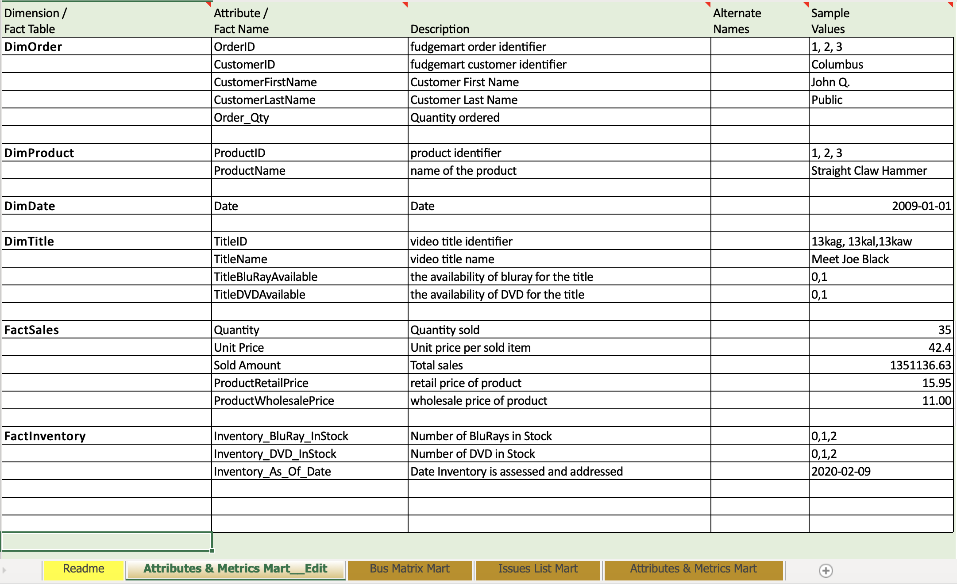
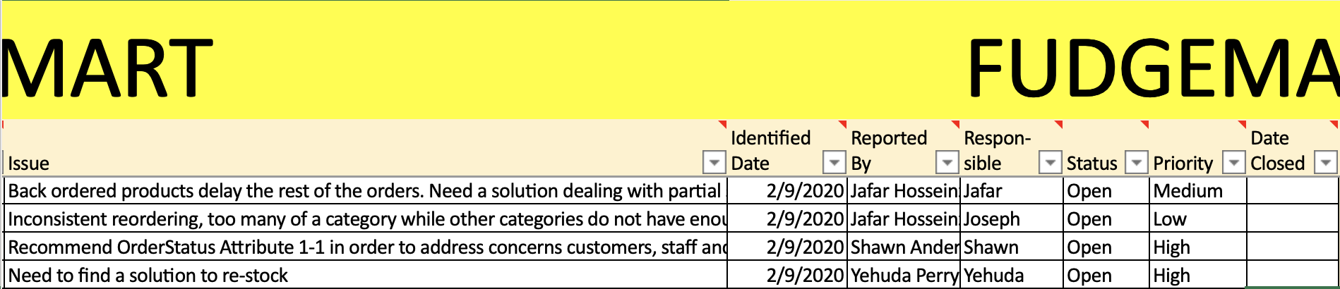
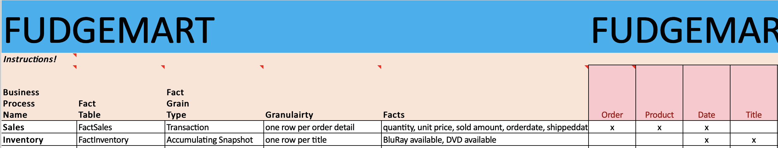
High Level Modeling
Attributes and Matrix
Open Issues
Business Processes and Facts

Slide 23
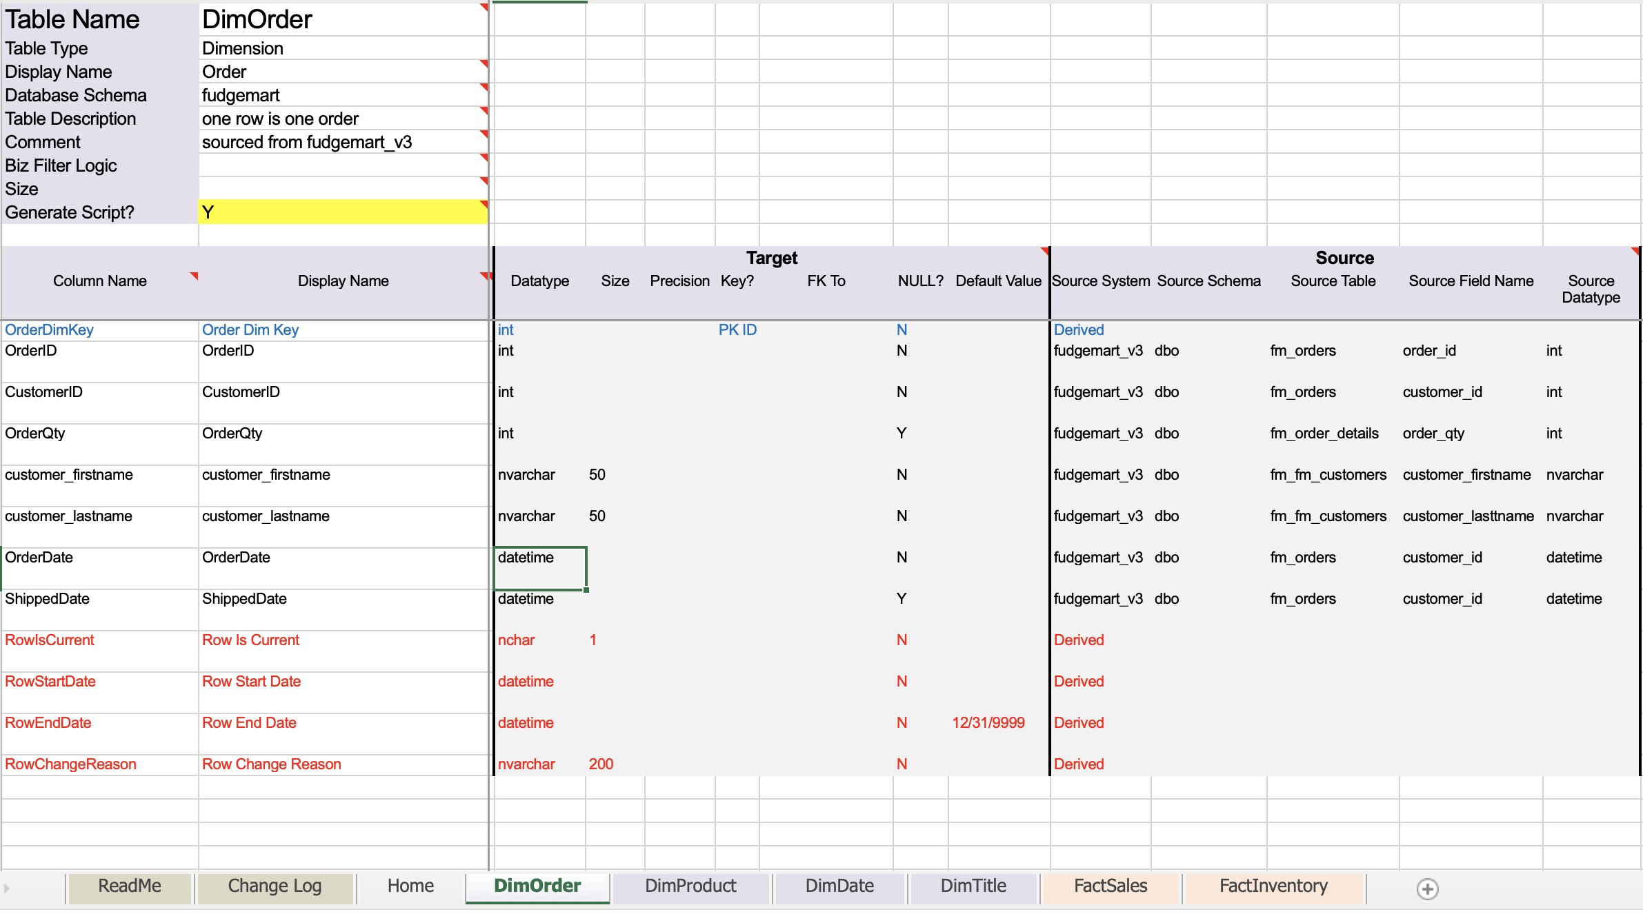
Detail Level Modeling
DimOrder

Slide 24
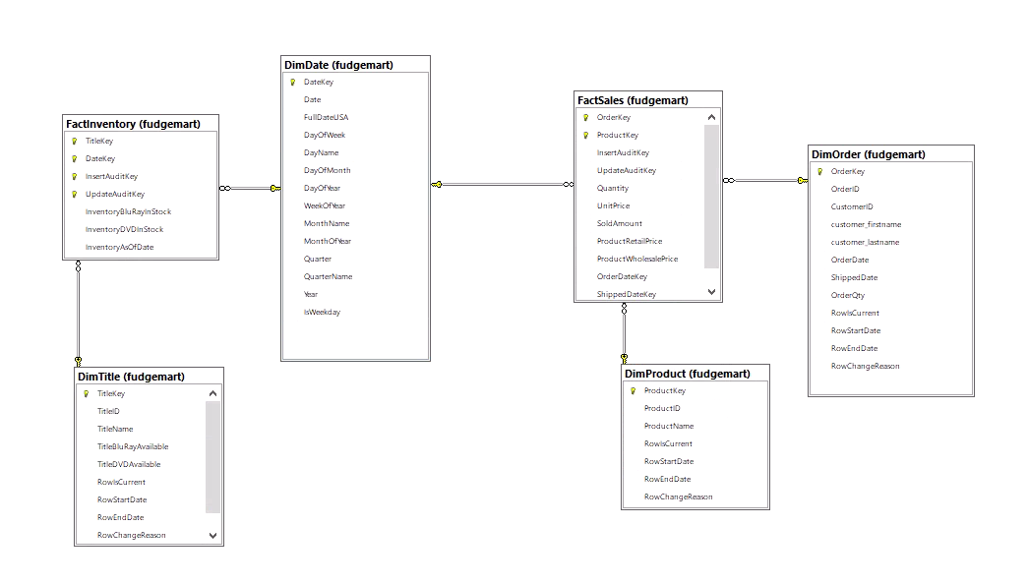
Schema

Slide 25
SSIS: Deployment

Slide 26
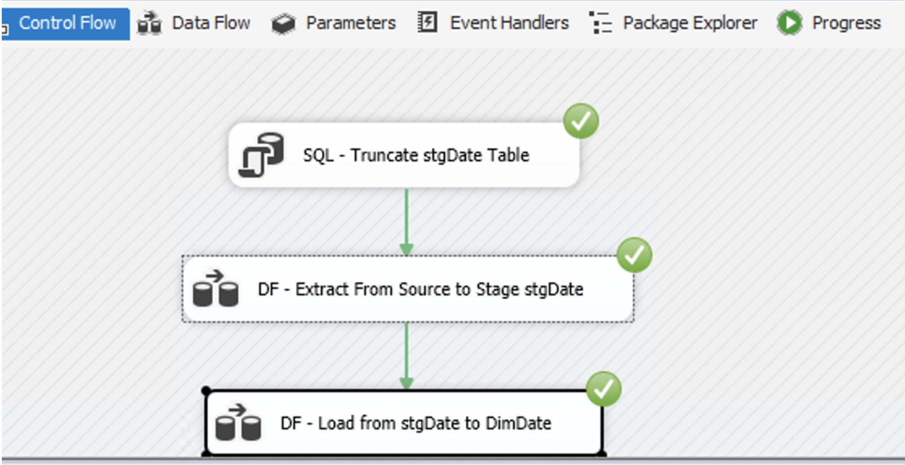
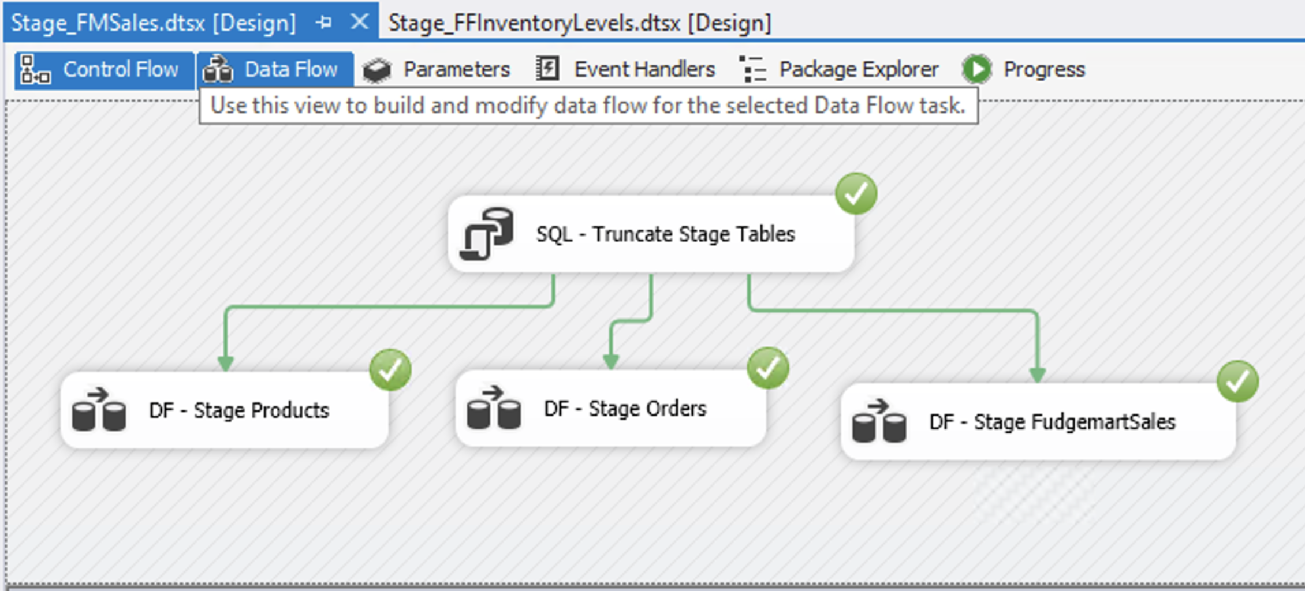
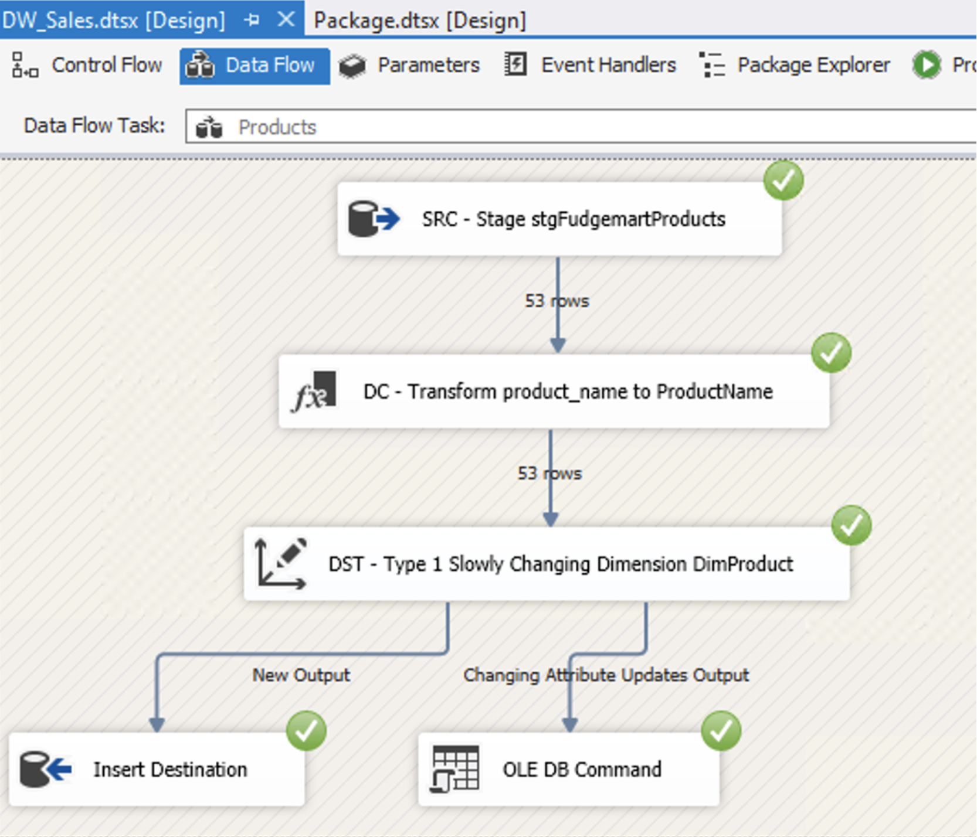
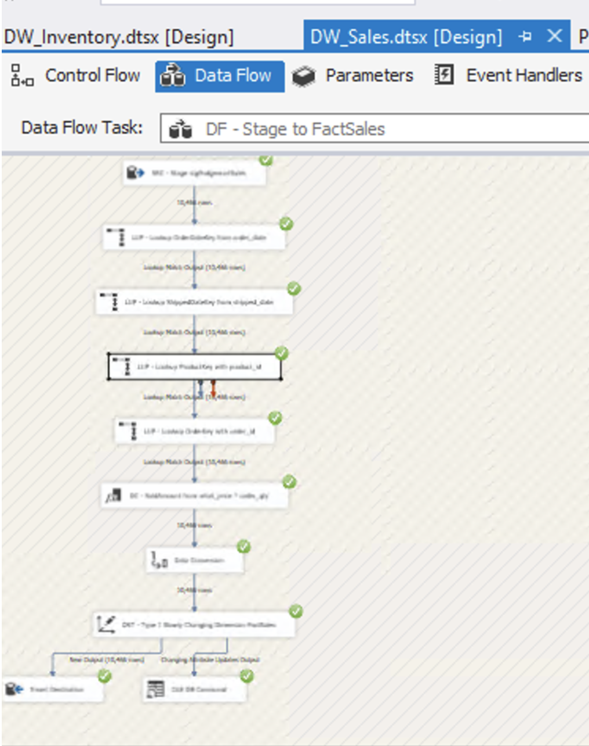
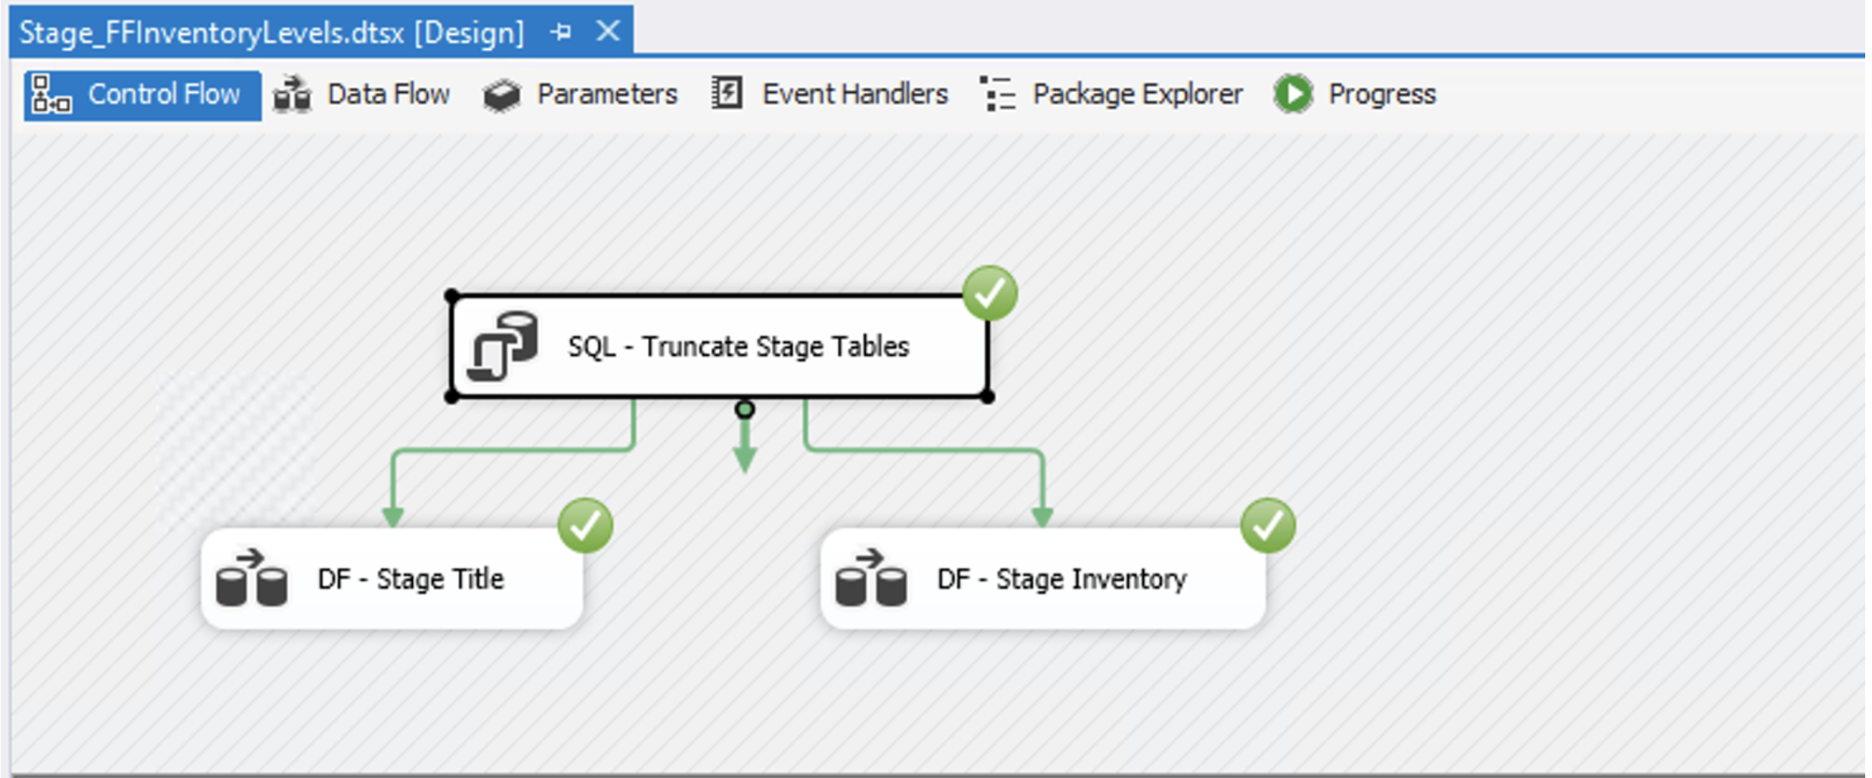
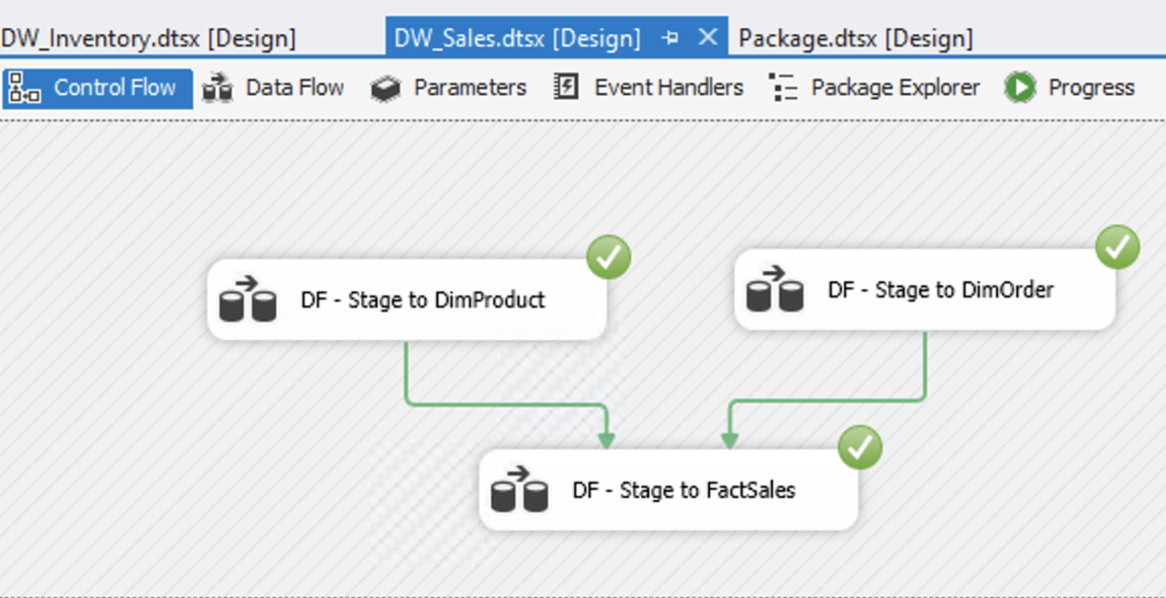
SSIS Packages
Truncated, Extract and Load DImDate
Stage FM Sales
DW Sales
Inventory
Product and Order

Slide 27
SSAS: Business Intelligence

Slide 28
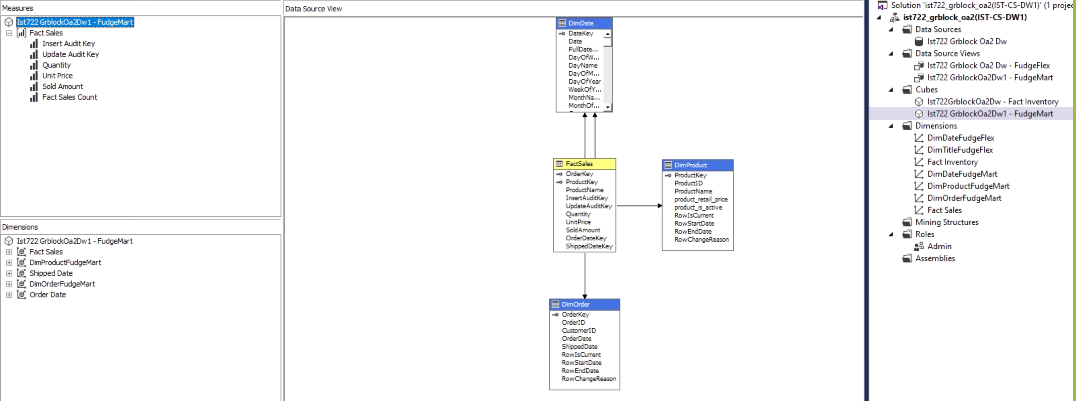
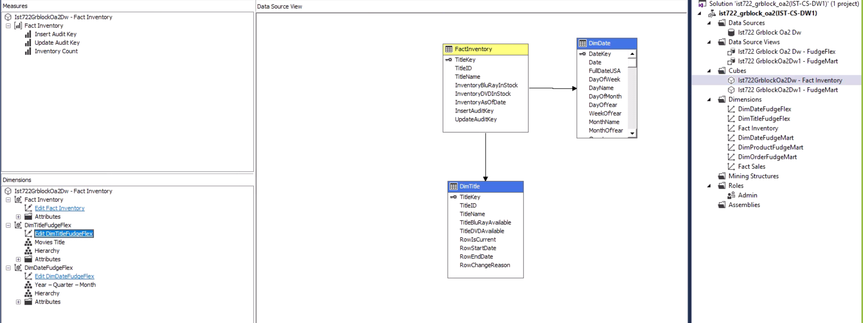
SSAS: Business Intelligence

Slide 29
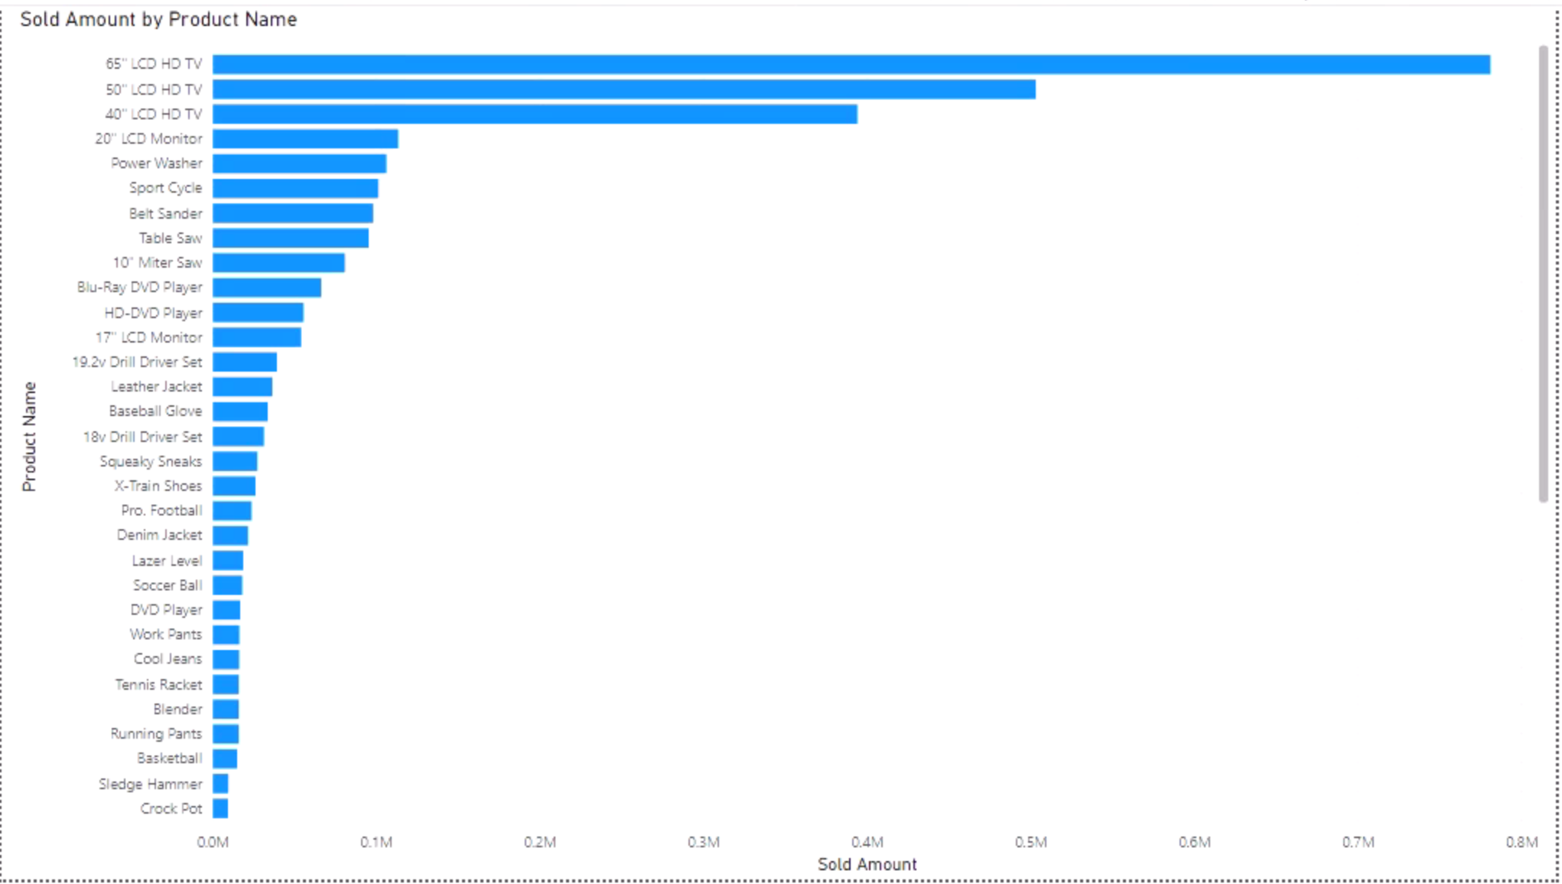
SSAS: Business Intelligence – Sold Amount by Product Name (Fact Sale)

Slide 30
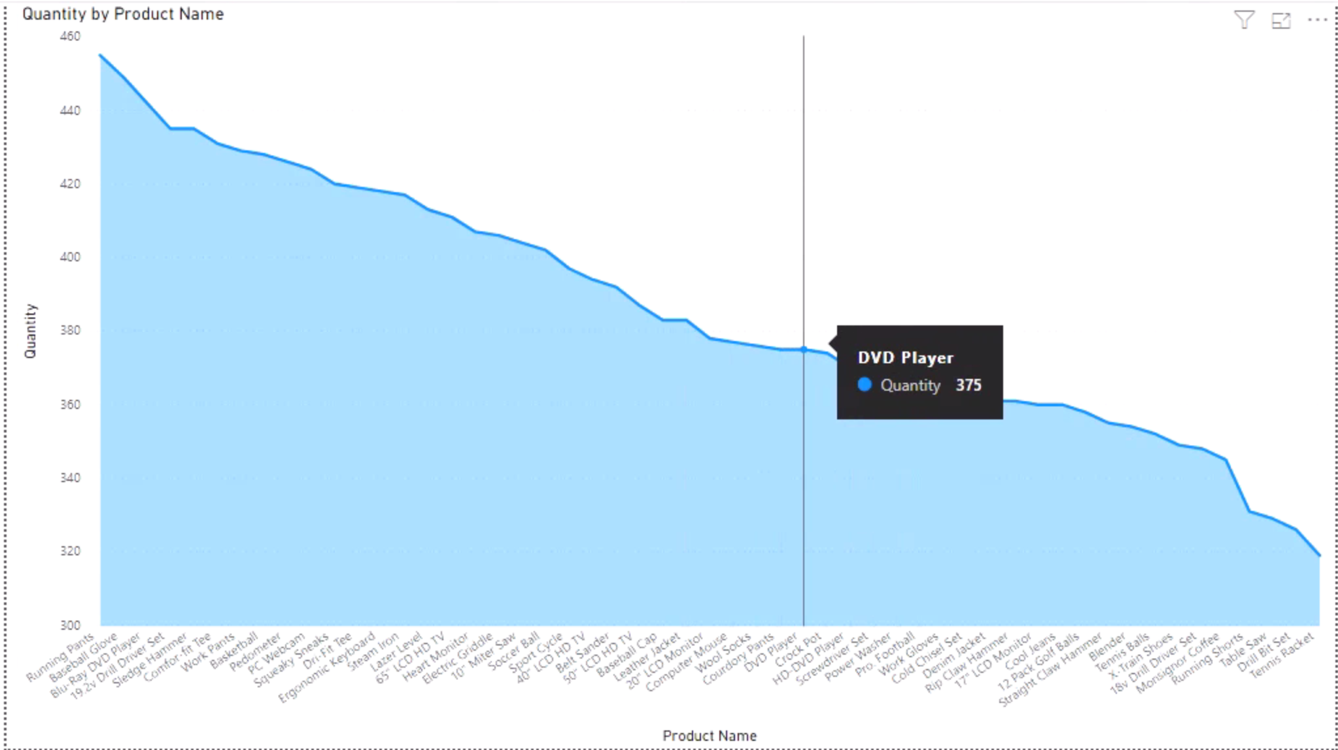
SSAS: Business Intelligence – Quantity by Product Name (Fact Sale)

Slide 31
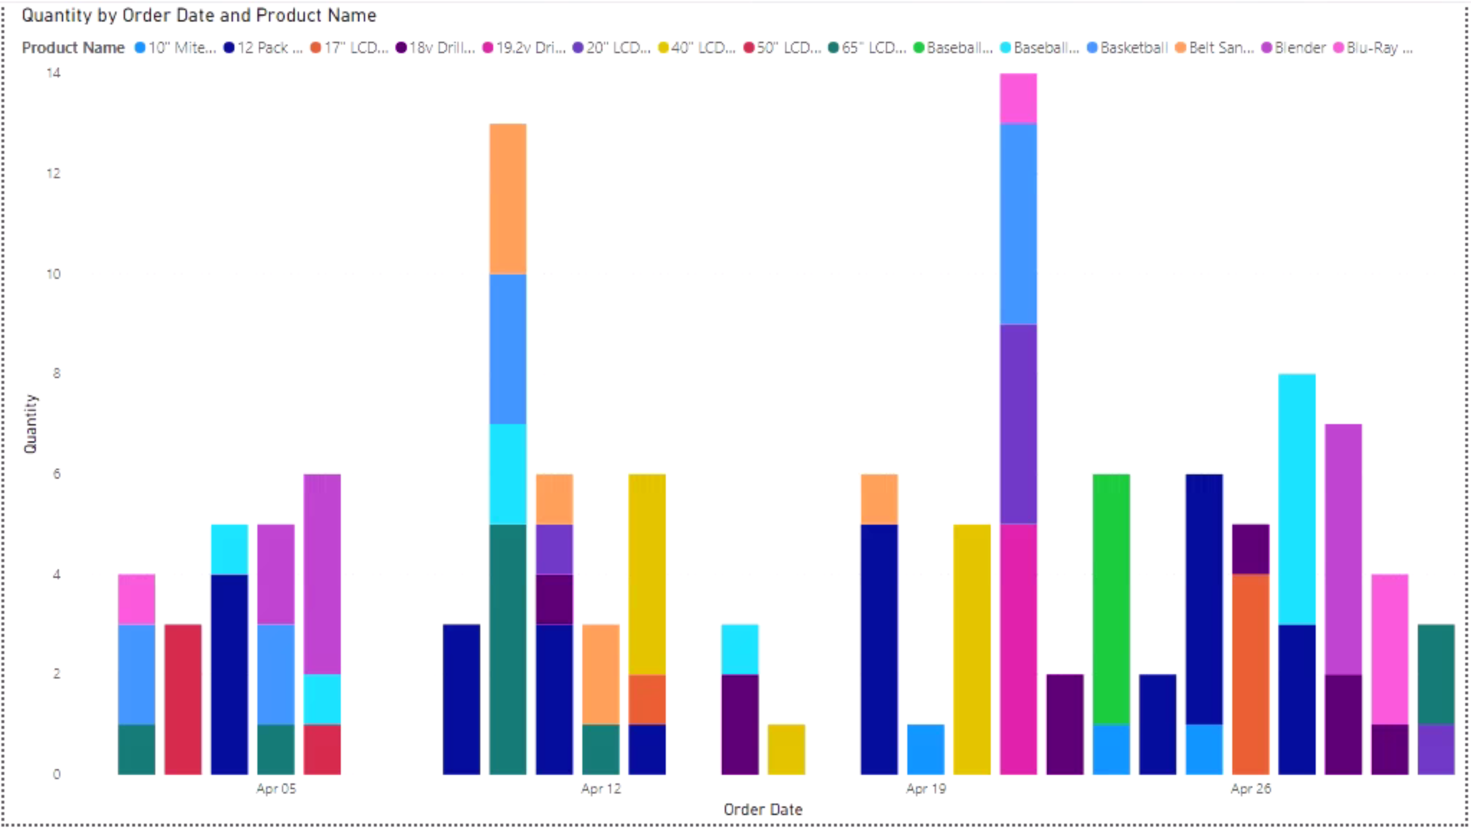
SSAS: Business Intelligence – Quantity by Order Date and Product Name (Fact Sale)

Slide 32
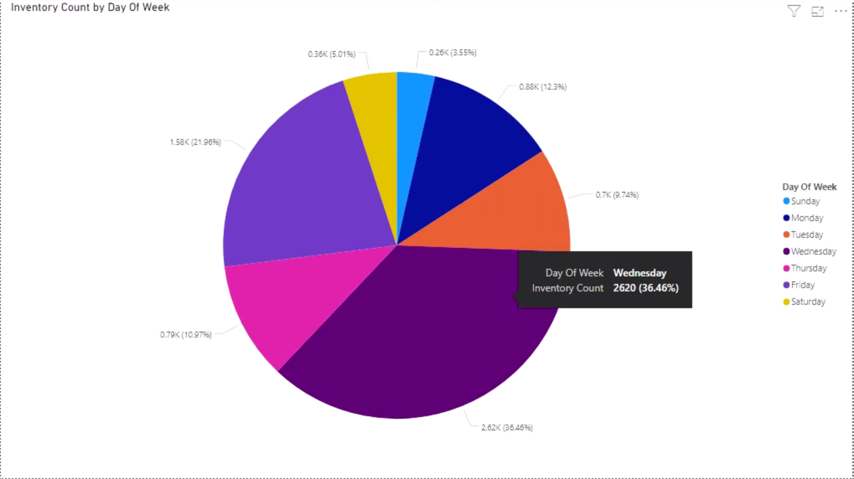
SSAS: Business Intelligence – Inventory Count by Day of Week (Fact Inventory)

Slide 33
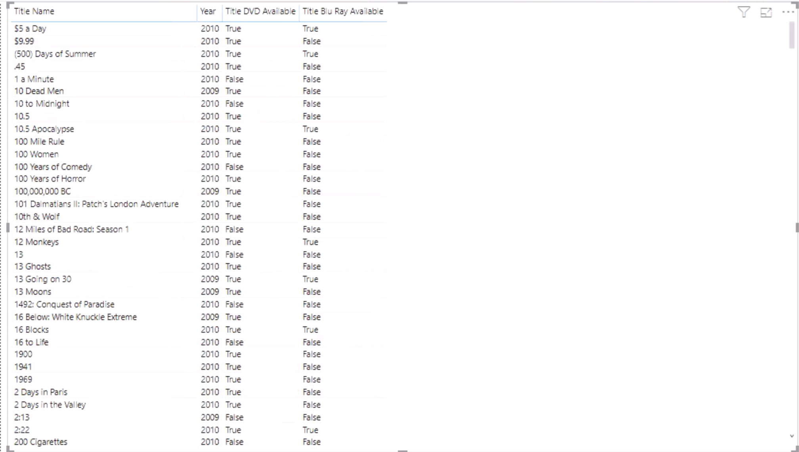
SSAS: Business Intelligence – Inventory Title Name, Year and Availability by DVD & BluRay

Slide 34
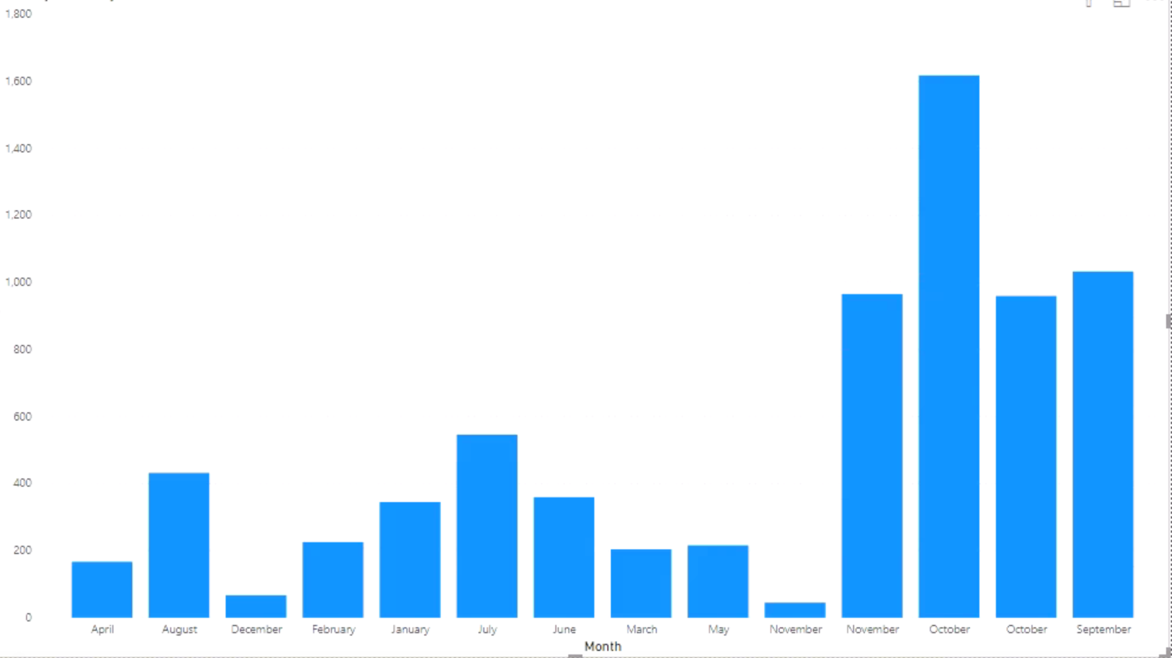
SSAS: Business Intelligence – Inventory by Month

Slide 35
Live Demo

Slide 36
Q&A

